Slide 1

SAFE TRAVELS POPULATION HEALTH DOMAIN
TEAM ROCKSTARS: CS-6400-O01
EDDIE FLAISLER, NOA NADLER, JOHN GADBOIS,
FORREST BRAZZEAL, RAVI RAINA

Slide 2
OVERVIEW
Project Update
Screen Prototypes/Demonstrations
Product Deployment
Outstanding Elements
Challenges We Faced
Next Steps

Slide 3
PROJECT UPDATE – EXECUTIVE SUMMARY
These are very exciting times for us here at SafeTravels. Our product is starting to take its final form and things are actually working. We made immense progress in finalizing our UI, user management, user registration and notification process, data extraction from our online resources and its analysis and utilization. Our current major challenge is FHIR integration for our user vaccinations feature. This effort is led by Forrest and John.
Brace yourselves. SafeTravels is coming.

Slide 4
PROJECT UPDATE - FEATURES
Completed Framework, Design, Implementation and Testing of the following features
User Management
Location to Disease Mapping
Disease to Local care and prevention
Completed Design and implementation of
Email Outbreak and Notification feature
Completed Design of Disease to Vaccination and Medical Mapping

Slide 5
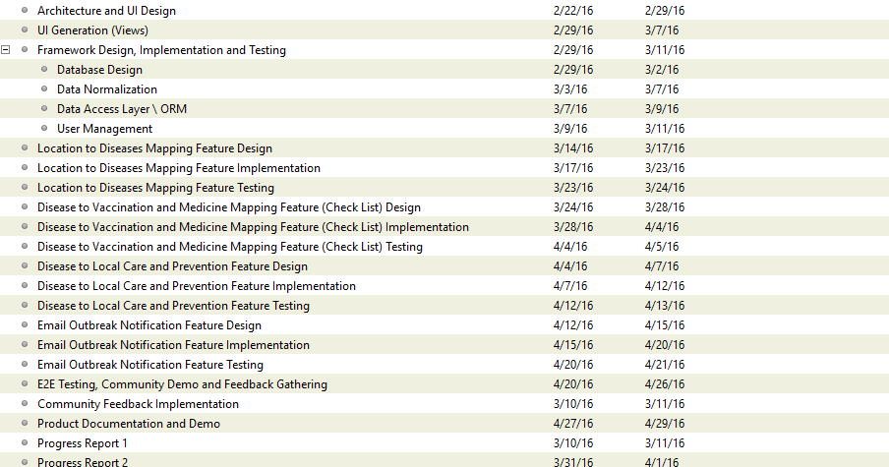
GANTT CHART
✓
✓
✓
✓
✓
✓
✓
✓
✓
✓
✓
✓
✗
✓
✓
✓
✓
✗
✗
✓
✓
✓
✓
✓
✓
✓

Slide 6
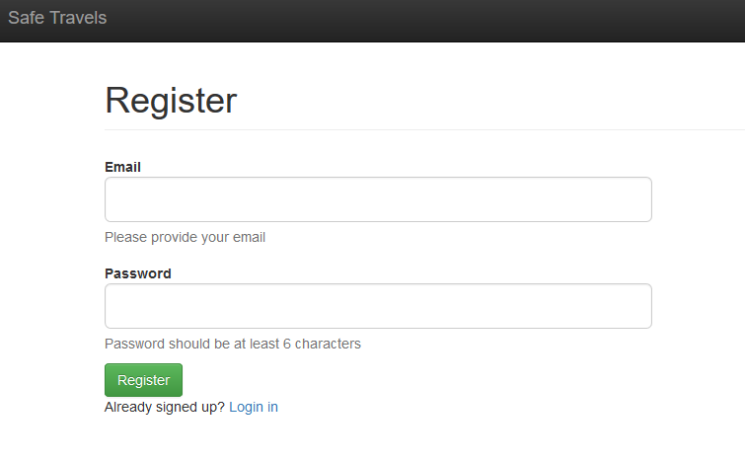
SCREEN PROTOTYPES
The following screen shows up on when user clicks our website. A new user can either register on the site, or existing users can login

Slide 7
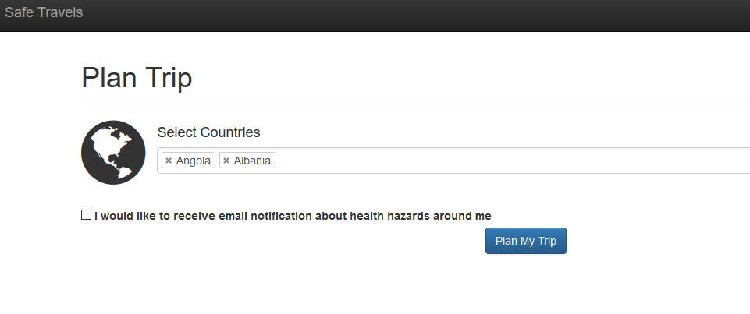
SCREEN PROTOTYPES
The application allows a user to select single or multiple countries that he/she is travelling to. There’s also option to receive email notification about health hazards.

Slide 8
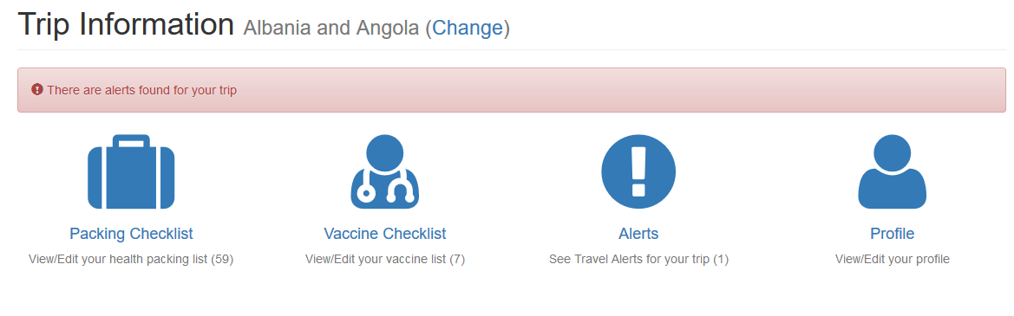
SCREEN PROTOTYPES
Our App provides the following dashboard for Trip Information.
Packing Checklist - List of items to pack for the trip
Vaccine Checklist – List of vaccines necessary or required for this trip
Alerts – Provides list of travel alerts for this trip
Profile – View/Edit the user profile

Slide 9
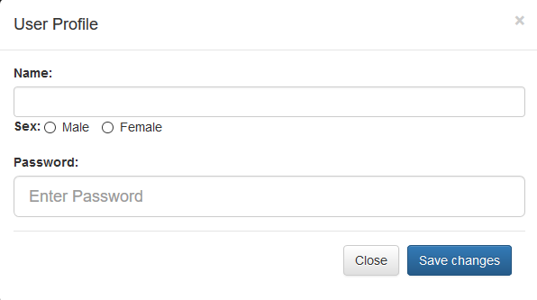
SCREEN PROTOTYPES
We also provide the functionality for a user to edit her user profile info, including Name, Sex, password…etc.

Slide 10

PRODUCT DEPLOYMENT
Our API is hosted on Heroku. We deploy our Java application to Heroku using their command line interface.
Our Javascript application is hosted on a second Heroku application and is deployed by pushing our git repository to their git remote server.

Slide 11
HIGH LEVEL PROJECT ARCHITECTURE

Slide 12
OUTSTANDING ELEMENTS OF APPLICATION
FHIR integration for our user vaccinations feature
Implementation and Testing of Disease to vaccination and medical mapping feature.
Testing of email notification feature
End to End Testing, community demo and feedback gathering.

Slide 13
CHALLENGES WE FACED
Integrating and authenticating with the FHIR server: We ultimately decided to create new FHIR users when a user account is created on safe-travels. We then can sync vaccine data from our application with FHIR. We also had to map all our CDC vaccine names to vaccine codes that are usable with FHIR.
Email Integration: We had some difficulty finding an email provider to integrate our application with. After hitting some dead ends, we decided to go with SendGrid which provided an easy-to-use Java API.

Slide 14
CHALLENGES WE FACED
UI Challenges: We had various UI challenges, specifically figuring out how to display CDC alerts and how to allow users to mark off vaccinations as current.
User Authentication Challenges: We spent significant time and effort extending our Java user authentication library, spark-pac4j, because some of the functionality we needed was not present by default.

Slide 15
NEXT STEPS
FHIR integration for our user vaccinations feature
Integration and Testing of the remaining features
End to End Testing, community demo and feedback gathering

